Slide 1
<number>
EDI: Electronic Data Interchange
What is EDI?
Exchange of electronic data between companies using precisely defined transactions
Set of hardware, software, and standards that accommodate the EDI process

Slide 2
.
Jan., 2012
The Main Requirements of EDI
The interchange has to be hardware independent.
The message syntax has to be unambiguous, although not always self-describing.
It has to reduce labor intensive tasks of exchanging data such as data reentry.
Should allow the sender to control the exchange, including knowing if and when a recipient has received the message.

Slide 3
History of EDI
.
Jan., 2012
Preliminary initiatives of trading groups increased and standardization in Europe soon became needed.
The first effort is TRADACOM, a UK standard developed by ANA in 1982 for general trade.
Other European countries developed similar standards such as SEDAS in Germany, and GENCOD in France. These standards have since migrated to EDIFACT.
North America had similar problems with industry groups making up their own standards rapidly.
In the beginning of the 80s ANSI took up the task of standardizing the EDI messages, in order to make cross-industry trade possible. The resulting standard is called ANSI X12.

Slide 4
The Structure of EDI Systems
.
Jan., 2012
The basic EDI structure is given below.
Each partner has their own internal software systems.
Special EDI adapters have to be implemented which will be able to interface with the internal system as well as communicate with the value added network.
The particulars of the message syntax and interaction process are negotiated between partners in advance. Sometimes a dominant partner will impose its standards on smaller partners.
Partner A
Internal
System
Partner B
Internal
System
VAN
EDI Software
VAN
EDI Software

Slide 5
.
Jan., 2012
Value Added Networks
Value Added Networks are the go-between in EDI communications.
The VAN is responsible for routing, storing and delivering EDI messages. They also provide delivery reports
Depending on the VAN type, messages may need extra envelopes or may be routed using intelligent VANs which are able to read the EDI message itself.
VANs may be operated by various entities
Telecom companies
Industry group consortiums
A large company interacting with its suppliers/vendors

Slide 6
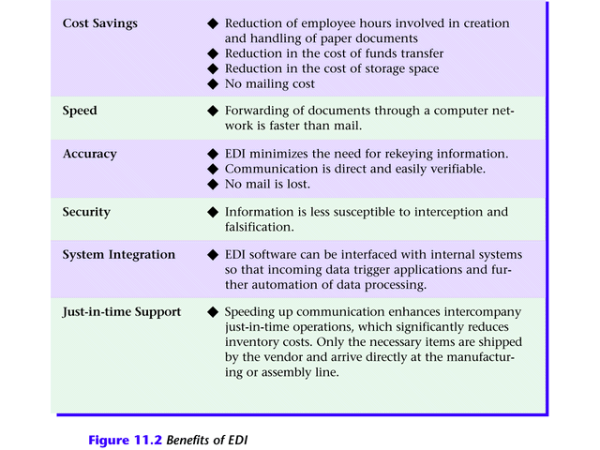
<number>
Figure 11.2 Benefits of EDI

Slide 7
.
Jan., 2012
Everyday Uses of EDI
Financial and monetary.
Systems like EFT all use EDI.
Governmental.
Payroll operations.
Official information sharing (e.g. For motor vehicle information, visas etc.).
Transportation.
IATA system is built on EDI. All airplane booking and ticketing operations done over EDIFACT.

Slide 8
.
Jan., 2012
Benefits of EDI
EDI is a well developed system with a lot of organizations using it extensively.
Contrary to popular belief EDI is not obsolete (outdated) . The explosion in EDI started occurring in the mid 1990s and EDI use is still growing.
Large organizations will probably continue to use EDI for the foreseeable future due to increased security and existing infrastructure investments.
Companies doing business with large organizations will need to implement EDI.

Slide 9
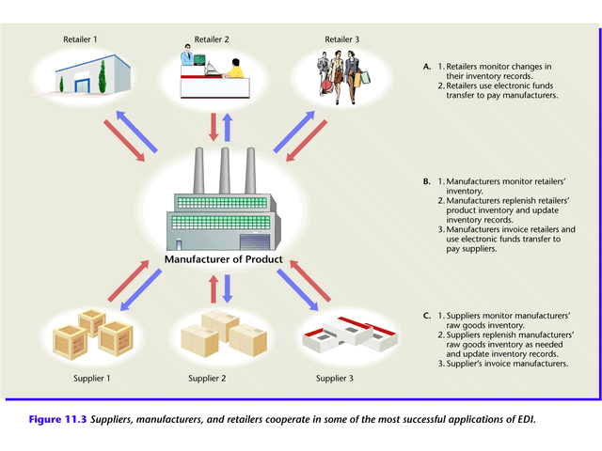
<number>
Electronic Data Interchange
Figure 11.3 Suppliers, manufacturers, and retailers cooperate in some of the most successful applications of EDI.

Slide 10
<number>
Electronic Data Exchange
How does EDI work? (Figure 11.4)
Supplier’s proposal sent electronically to purchasing organization.
Electronic contract approved over network.
Supplier manufactures and packages goods, attaching shipping data recorded on a bar code.
Quantities shipped and prices entered in system and flowed to invoicing program; invoices transmitted to purchasing organization

Slide 11
<number>
Electronic Data Exchange
Manufacturer ships order.
Shipment notice EDI transaction sent (not shown)
Purchasing organization receives packages, scans bar code, and compares data to invoices actual items received.
Payment approval transferred electronically.
Bank transfers funds from purchaser to supplier’s account using electronic fund transfer (EFT).

Slide 12
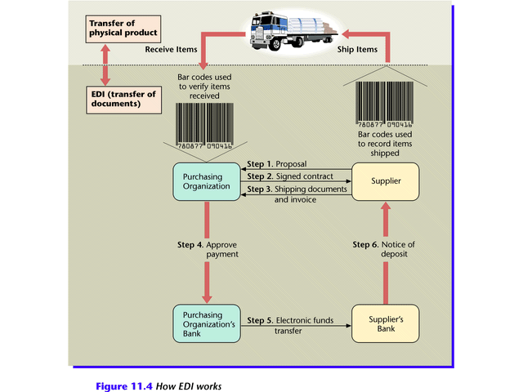
<number>
Electronic Data Interchange
Figure 11.4

Slide 13
<number>
Electronic Data Interchange
EDI Standards
EDI requires companies to agree on standards
Compatible hardware and software
Agreed upon electronic form format
Established EDI standards
Automotive Industry Action Group (AIAG)
X.12 de facto umbrella standard in U.S. and Canada
EDI for Administration, Commerce, and Trade (EDIFACT) umbrella of standards in Europe

Slide 14
.
Jan., 2012
EDIFACT
EDIFACT stands for EDI for administration, commerce and transportation.
It has been introduced by the UN center for the facilitation of administration, commerce and transportation (UN/CEFACT) in the mid 1980s.
Older European EDI standards such as TRADACOM, GENCOD, SEDAS and ODETTE have all migrated to EDIFACT.
EDIFACT has furthermore has become an international standard as ANSI has stopped all work on X12 since 1997 and X12 systems are migrating to EDIFACT.

Slide 15
<number>
Electronic Data Interchange
How to Subscribe to EDI
Larger companies purchase hardware and software
Medium and small companies seek third-party service
Value-added networking (VAN)
Managed network services available for a fee

Slide 16
<number>
Electronic Data Interchange
EDI on the Web
Advantages of Web EDI
Lower cost
More familiar software
Worldwide connectivity
Disadvantages of Web EDI
Low speed
Poor security

Slide 17
<number>
Electronic Data Interchange
The Importance of EDI
Need for timely, reliable data exchange in response to rapidly changing markets
Emergence of standards and guidelines
Spread of information into many organizational units
Greater reliability of information technology
Globalization of organizations

Slide 18
.
Jan., 2012
A Case in EDI: Alcatel-Bell Telephone
Alcatel Bell Telephone is Belgium’s most prominent exporter of telecommunications equipment and systems for both private and public networks.
The key strategies employed by the company for its dominance were flexibility and short lead times.
In order to increase its flexibility towards customers the company decided to increase its flexibility towards suppliers.
It therefore started deploying EDI in several phases from 1990 to 1994.

Slide 19
.
Jan., 2012
Alcatel Bell: Facts
The company was first founded in 1882 as a subsidiary of Bell Co. in the US. After the antitrust cases of 1928 the European divisions formed ITT which later became Alcatel in 1982.
Operates 10 plants in Belgium, 4 abroad and 12 overseas offices.
50% of its turnover (1 Billion $ in 1991) comes from exports to over 80 countries.
Purchases of materials and components accounted for 60% of the costs of goods sold.
There existed about 1250 suppliers, 100 of which generated about 70% of all orders. 22 suppliers were critical for the supply chain.

Slide 20
.
Jan., 2012
EDI project details
The main aim of Alcatel was to perform 80 – 90% of all financial, transport and commercial transactions over EDI.
The project started in 1989 and lasted until 1994. The first phase aimed to build the buyer-supplier EDI relationships.
By mid-1992 all 22 critical suppliers had implemented purchase order functionality
4 of these links were totally ‘paperless’.
3 of the 22 also employed Price Sales Catalog functionality.
By mid-1993 the remaining 18 key suppliers had joined.
By the end of 1994, 100 suppliers were linked with processes such as Price Sales Catalog, Purchase Order, Purchase Order Response, Purchase Order Change Request, Delivery Schedule, Dispatch Advice and Invoice

Slide 21
.
Jan., 2012
Impact of EDI on Alcatel
Shorter lead times, more flexibility and less inventory
A purchase negotiation which used to take 2 weeks now took 24 hours.
About 1 million $ reduction in the inventory cost
Greater Accuracy
Reduced Manpower
Total annual tangible benefits to Alcatel: 0.5 M$ with costs for installation and operation being only 30000 $.

Slide 22
.
Jan., 2012
Drawbacks of EDI
EDI adapter software is too expensive for most organizations.
The software has to be practically rewritten for different combinations of VANs, internal hardware and trading scenarios.
The software is also subject to change when there is a revision in EDIFACT
VAN subscription costs and dedicated line costs are high-priced for most SMEs
The EDI system is highly static and every business process has to be thoroughly negotiated between partners.
Since there is no common registry or discovery mechanism, partners have to retain information on institution codes, product codes, up-to-date catalogs etc. associated with everybody they do business with.

Slide 23
<number>
The first six numbers are related to the manufacturer and the type of transaction, the next five describe the product or item number. The last number is the checkdigit, which is used to validate that all of the other numbers have been read correctly by a scanner. The calculation for validation is elaborate.

